Slide 1

A La Carte Sales
And Inventory Form
Provided by the LAUSD Food Services Division

Slide 2

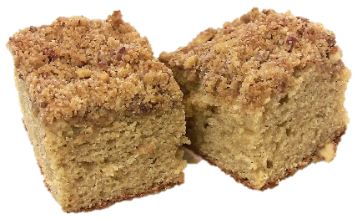


Objective
To have a working knowledge for both student and faculty a la carte sales, understanding the required forms, and how to complete them.

Slide 3
A La Carte Sales and Inventory Forms
The A La Carte Sales and Inventory form is used to ensure accuracy and accountability of all a la carte sales.
Use current price list for each school year
A La Carte forms are used for students and adults
Reconciles cash collected
Supports and tracks non-reimbursable meals and adult BIC meals
Requires verification signatures
Retain for auditing purposes

Slide 4
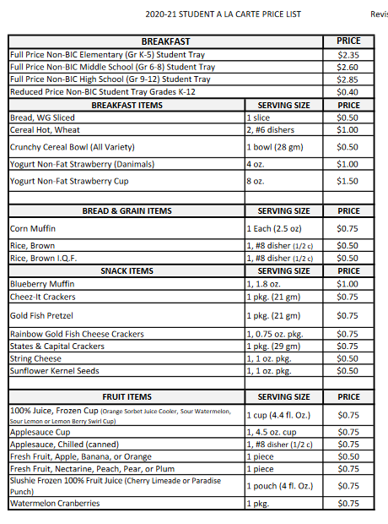
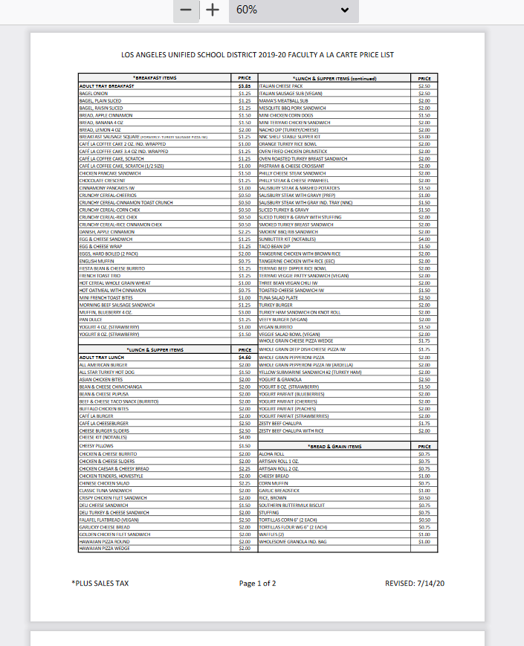
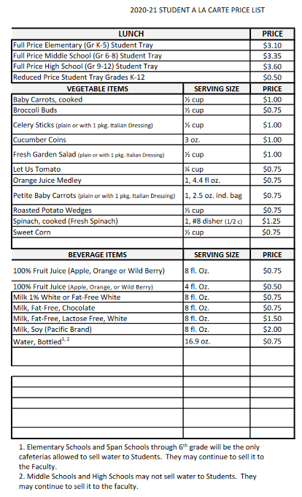
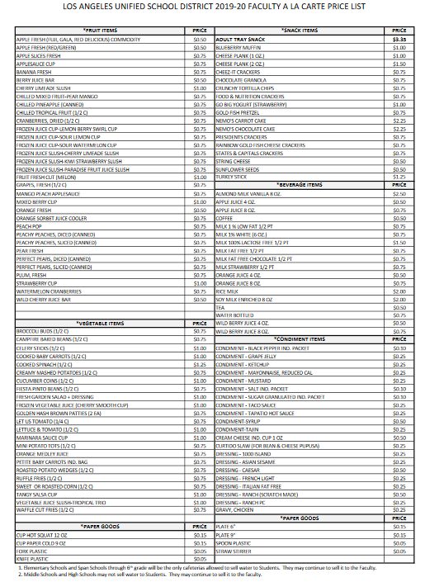
A La Carte Price Lists
Price lists for students and faculty are updated annually. Lists should be available at each POS.
Student A La Carte Price List
Faculty A La Carte Price List
Price lists change annually.

Slide 5
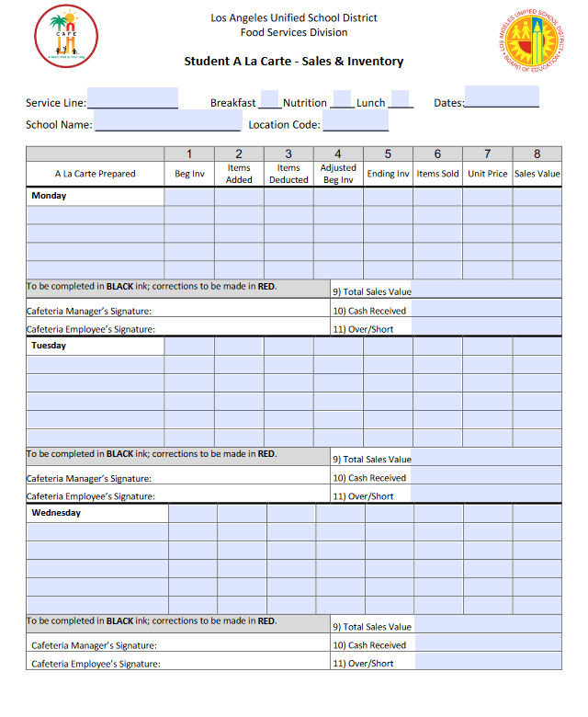
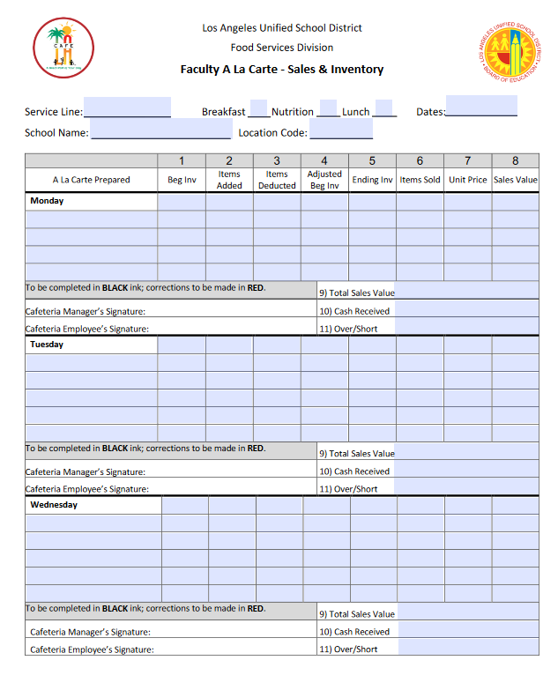
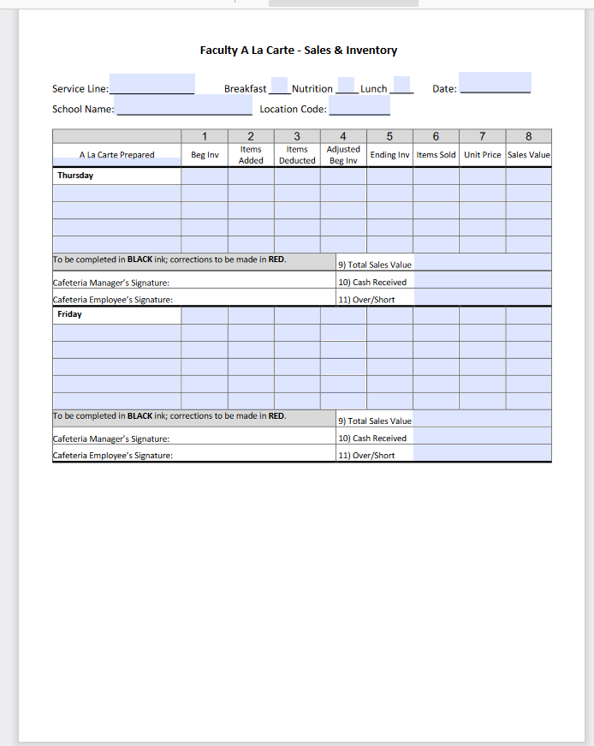
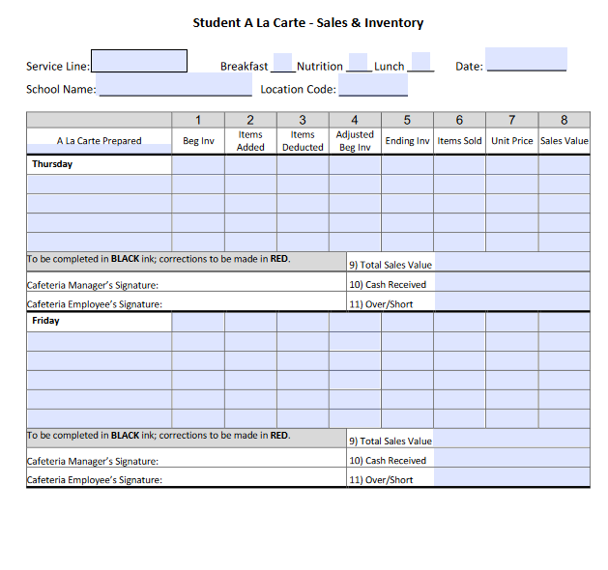
Student & Faculty A La Carte Sales & Inventory Forms+++++++++
Student A La Carte
Faculty A La Carte

Slide 6
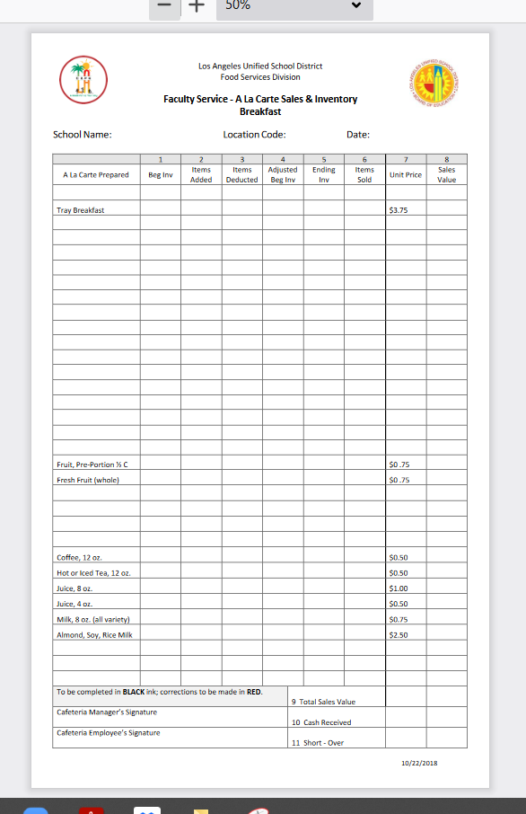
Faculty A La Carte Sales & Inventory
A La Carte pricing may change annually.

Slide 7
Form Etiquette And Filing Requirements
The A La Carte Sales and Inventory Form is completed in black or blue ink.
Red ink is used when making any corrections to the original figures.
Draw a red line through the changed figure
Add the correction
Add the initials of the person making the change
File completed forms in Folder #3
A La Carte Sales And Inventory Forms

Slide 8
How To Complete Form Heading
Complete heading:
School Name
Location Code
Date
Month, Date and Year
Beaudry El
1234
1/5/21

Slide 9
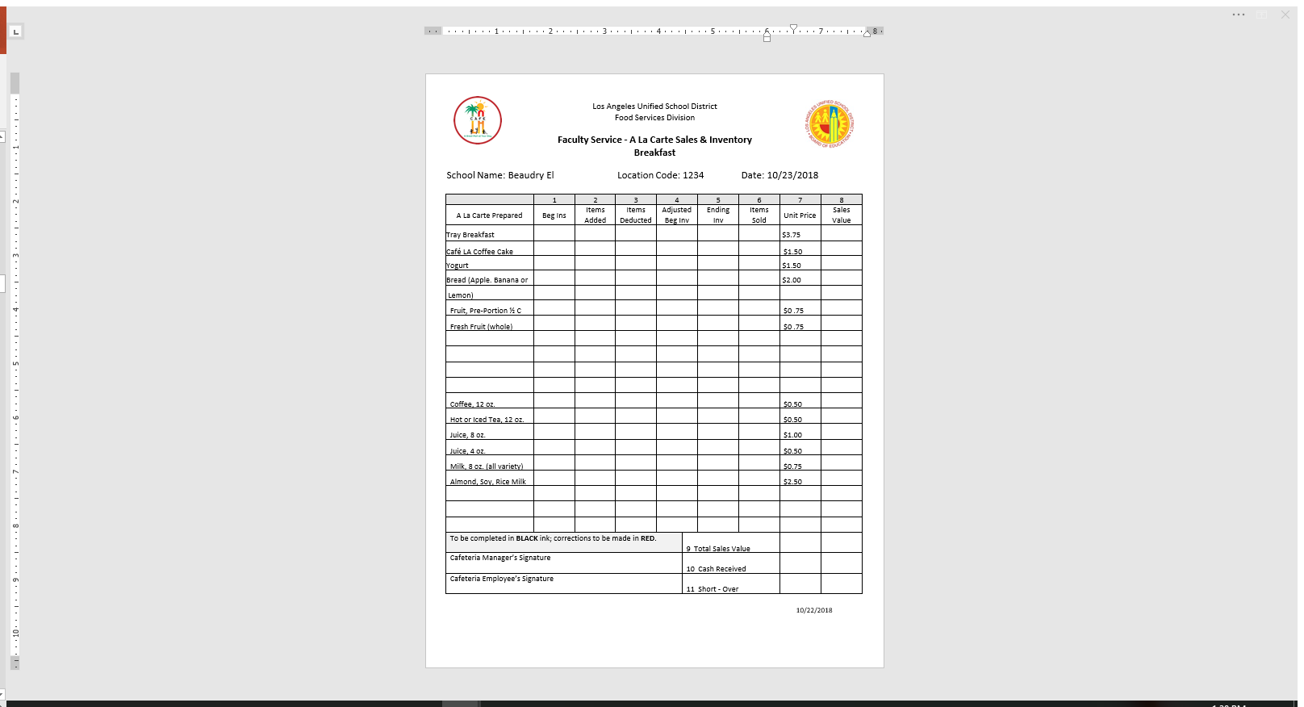
How To Complete Columns 1 - 3
Col. 1-Beginning Inventory
Enter the beginning amounts of items prior to service.
Col. 2-Added Items
Add additional items if you sell out and required additional items.
Col. 3-Items Deducted
Enter the amounts of items transferred to another service line.
5
0
2
5
0
0
5
0
0
5
5
3
5
5
0
Notes:
NOTE: Use The Breakfast form to Track Adult BIC Meals.

Slide 10
How To Complete Column 4 (No Action)
Col. 4- Beg Inv
If no items are added or deducted to the beginning inventory, the “adjusted beginning inventory” (column 4) is equal to “beginning inventory” (column 1) amount.
Example: Café LA Coffee Cake
Start with 5 cakes; no coffee cakes were added/deducted from the inventory.
5
0
2
3
5
0
0
5
5
0
0
5
5
5
3
5
=
5
5
5
0
Adjusted beginning inventory is 5
Notes:
NOTE: Use The Breakfast form to Track Adult BIC Meals.

Slide 11
Column 4 – Items Added
Col. 4-Beg Inv
Add “items added” (column 2) to “beginning inventory” (column 1) when column 3 is zero.
Example Coffee 12 oz.
Begun with 5 coffee cups, sell out and need to add 5 more coffee cups for the remainder of service.
5
0
2
3
5
0
0
5
5
0
0
5
5
+
5
-
0
=
10
5
5
0
10
5
5
0
10
Adjusted beginning inventory is 10
Notes:
NOTE: Use The Breakfast form to Track Adult BIC Meals.

Slide 12
Column 4 - Items Deducted
Col. 4-Beg Inv
Subtract the “items deducted” (column 3) from “beginning inventory” (column 10) when column 2 is zero.
Example: Tray Breakfast
Beginning amount is 5 trays, no trays were added, and 2 breakfast trays were dropped.
5
0
2
3
5
0
0
5
5
0
0
5
5
-
2
=
3
5
5
0
5
5
0
Adjusted beginning inventory is 3
Notes:
NOTE: Use The Breakfast form to Track Adult BIC Meals.

Slide 13
How To Complete Column 5
2
1
2
Col. 5-Ending Inv
After meal service is completed, count all remaining items leftover and enter the amount in “ending inventory” (column 5).
3
5
Notes:
NOTE: Use The Breakfast form to Track Adult BIC Meals.

Slide 14
How To Complete Column 6
Col. 6-Items Sold
Subtract “ending inventory” (column 5) from “Adjusted beginning inventory” (column 4) to determine the amount of items sold.
Example: Tray Breakfast
“Adjusted beginning inventory” (column 4) was 3, 2 trays were dropped, and 1 tray sold.
3
2
1
3
-
2
=
1
Notes:
NOTE: Use The Breakfast form to Track Adult BIC Meals.

Slide 15
How To Complete Column 6
Col. 6-Items Sold
Subtract “ending inventory” (column 5) from “Adjusted beginning inventory” (column 4) to determine the amounts of items sold.
Example: Tray Breakfast
“Adjusted beginning inventory” (column 4) was 3, there were 2 items left in ending inventory; resulting in 1 tray sold.
3
-
2
=
1
5
0
2
3
2
1
Notes:
NOTE: Use The Breakfast form to Track Adult BIC Meals.

Slide 16
Coffee Cake Example
Col. 6-Items Sold
Subtract “ending inventory” (column 5) from “adjusting beginning inventory” (column 4) to yield “items sold” (column 6).
Example: Coffee Cake
“Adjusted beginning inventory” (column 4) is 5, the “Ending inventory” (column 5) has 1 item remaining, resulting to in 4 cakes sold.
3
2
1
5
1
4
5
2
7
3
10
5
5
-
1
=
4
Notes:
NOTE: Use The Breakfast form to Track Adult BIC Meals.

Slide 17
Activity: Yogurt, Coffee, Tea
Determine the amount of yogurt, coffee, and tea sold.
3
2
1
5
1
4
5
2
3
Yogurt
5
-
2
=
3
Coffee
10
-
3
=
7
10
3
7
10
5
5
Hot or Iced Tea
10
-
5
=
5
Refer to the “Activity Sheet” at the end of this presentation in your MCC manual.
Notes:
NOTE: Use The Breakfast form to Track Adult BIC Meals.

Slide 18
How To Complete Column 7
Col. 7-Unit Price
Use the current Faculty A La Carte price list for each item.
Notes:
NOTE: Use The Breakfast form to Track Adult BIC Meals.

Slide 19
How To Complete Column 8
Col. 8-Sales Value
Multiply “items sold” (column 6) by the “unit price” (column 7) to determine the “sales value” (column 8).
Example: Tray Breakfast
1 tray breakfast sold, multiplied by unit price, yields the sales value.
1
X
$3.75
=
$3.75
5
0
2
3
2
1
$3.75
Notes:
NOTE: Use The Breakfast form to Track Adult BIC Meals.

Slide 20

Activity #1: Sales Value
Determine the sales value for the coffee cake and yogurt sold.
Coffee Cake
Yogurt
4
X
$1.50
=
$6.00
3
X
$1.50
=
$4.50
5
0
2
3
2
1
$3.75
5
0
0
5
1
4
$6.00
5
0
0
5
2
3
$4.50
Notes:
NOTE: Use The Breakfast form to Track Adult BIC Meals.

Slide 21
Activity #2: Sales Value
Determine the sales value for the coffee and tea sold.
Coffee
Hot or Iced Tea
7
X
$0.50
=
$3.50
5
X
$0.50
=
$2.50
5
5
0
10
3
7
$3.50
5
5
0
10
5
5
$2.50
Notes:
NOTE: Use The Breakfast form to Track Adult BIC Meals.

Slide 22
Completing Rows 9 And 10
2
1
$3.75
1
4
$6.00
2
3
$4.50
Row 9 – Total Sales Value
Add all items in “sales value” (column 8) together and enter the total in “total sales value” (row 9).
Row 10 - Cash Received
Enter amount of cash received in “cash received”(row 10).
3
7
$3.50
5
5
$2.50
$20.25
$22.28

Slide 23
Completing Row 11
Row 11 - Over/Short
Subtract the “cash received” (row 10) from “total sales value” (row 9). Enter the amount in “short/over” (row 11). Circle either Over or Short. Write a comment at the bottom of the form to explain the overage or shortage.
$22.28
-
$20.25
=
$2.03
$20.25
$22.28
$2.03
Over amount due to state tax

Slide 24

Verification Signatures
After tabulating all columns and rows, the cafeteria employee will sign the form in black or blue ink.
After reviewing for accuracy, the cafeteria manager will sign the form in black or blue ink.
If only one person is completing and verifying the form, the same person will sign on both signature lines.
$20.25
Bobby Flay
$22.28
Ina RosenbergGarten
$2.03
Over amount due to state tax

Slide 25
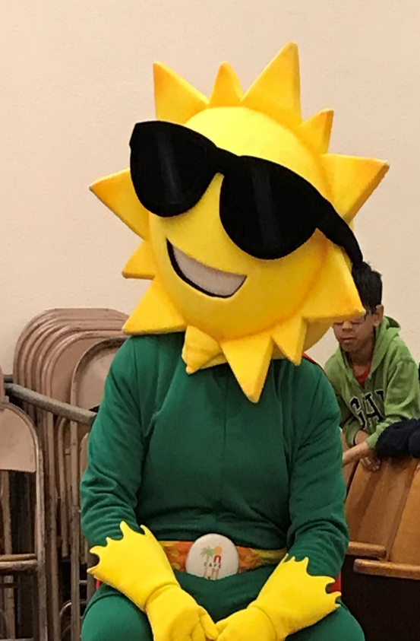
Questions

